Slide 1

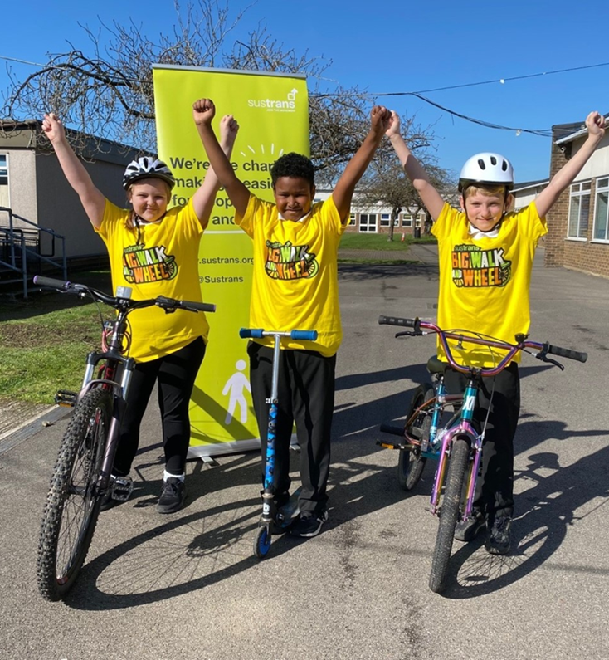

Big Walk and Wheel at
[SCHOOL NAME]

Slide 2
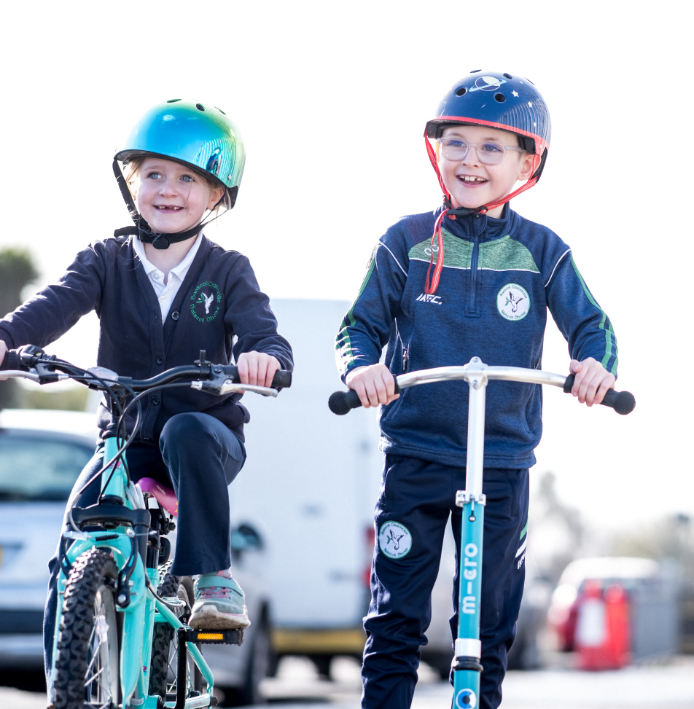

What is it?
Big Walk and Wheel is the UK’s largest walking, wheeling, scooting and cycling to school challenge.
Let’s see how many active journeys to school we can record over two weeks!
Photo: Stephen Latimer

Slide 3
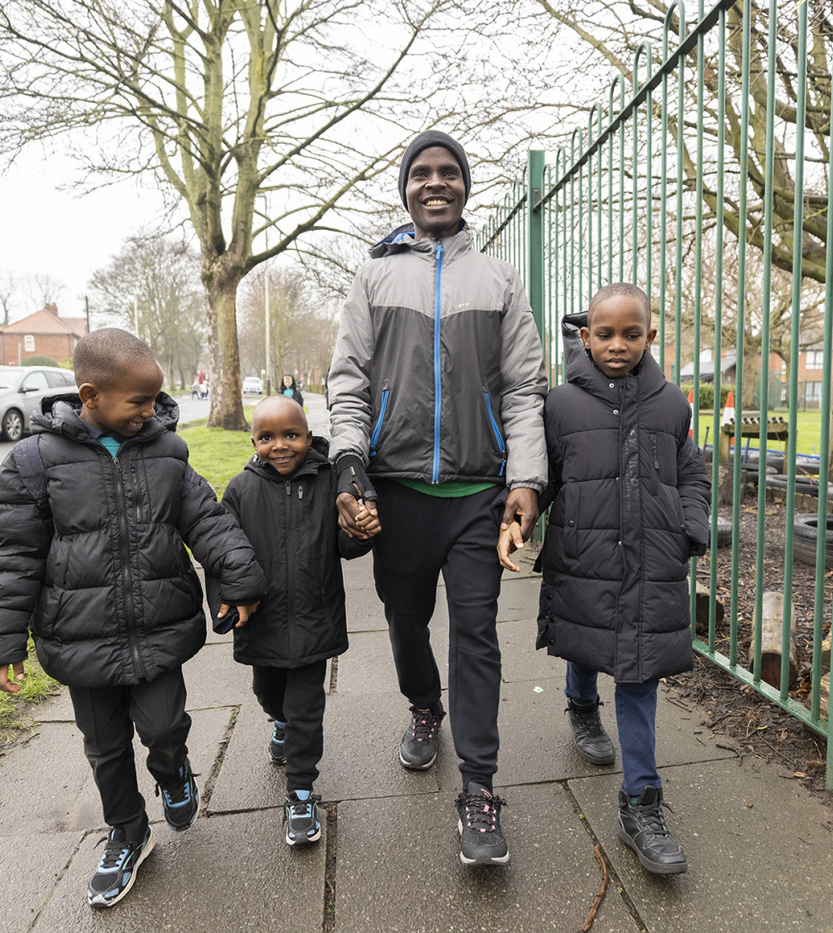

When is it?
Big Walk and Wheel runs from Monday 16 March – Friday 27 March.
We can take part for all ten days of the challenge but only the best five days will decide our final position.
Photo: Mark Savage photography

Slide 4
What do you think is good about walking, wheeling, cycling or scooting to school?
Travelling actively is great exercise and helps us stay healthy.
Travelling actively to school means we arrive more alert and ready to learn!
Walking, wheeling, cycling and scooting to school is fun!
More people travelling actively to school means cleaner air, less traffic and less noise around the school.
We can win prizes!
Notes:
Before revealing the reasons ask the children what they think are the benefits of walking, wheeling, cycling and scooting to school.

Slide 5
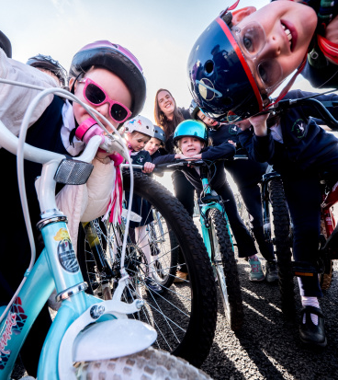

Why are we taking part?
We want to be part of something BIG!
By taking part, we will learn about how changing our journey to school can help us change our world for the better!
Photo: Stephen Latimer

Slide 6
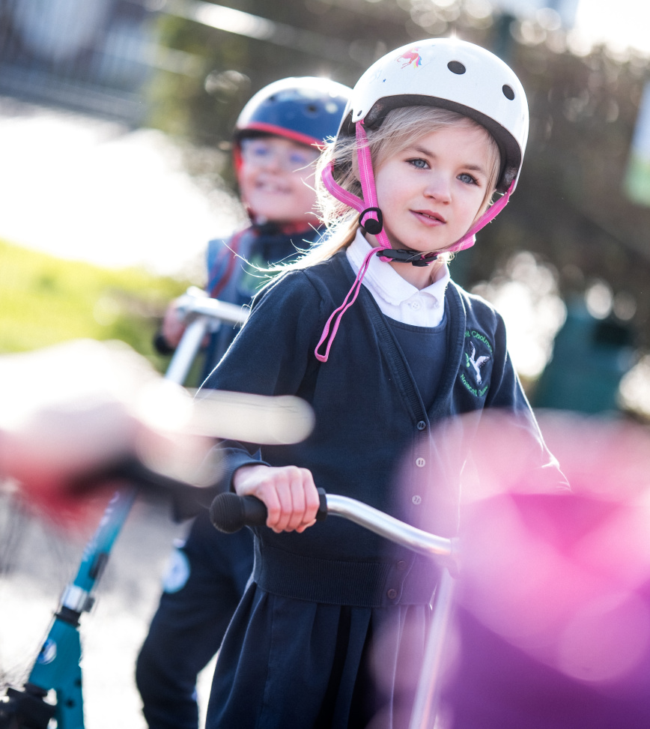
What do we need to do?
Walk, wheel, scoot or cycle to school as many times as you can!
Ask your teachers about the inclusivity guide if you think you need help to take part.
Encourage your friends to join in too!
Remember to tell your teacher about your active journey to school so it can be logged and added to our total!
Take part in the exciting activities at school.
Photo: Stephen Latimer

Slide 7
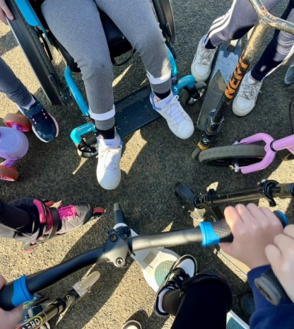
Don’t forget about the prizes!
There will be fantastic prizes up for grabs on every day of the challenge. Schools that get over 15% of their pupils taking part on each day will be entered into the daily prize draw.
Prizes include accessories and equipment to help our school travel actively.
The more people we have making active journeys the better chance we have of winning a prize!
Photo: Walk Wheel Cycle Trust

Slide 8
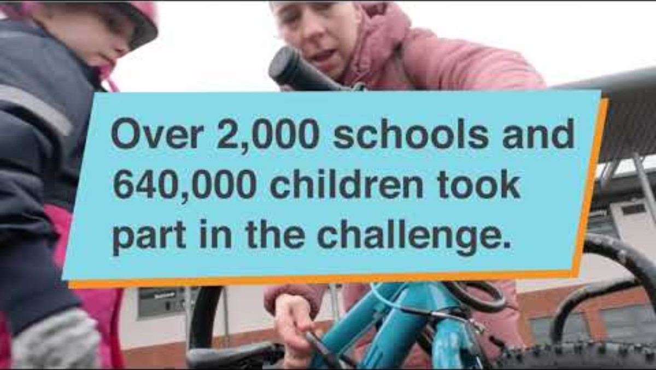

Big Walk and Wheel 2025 - the biggest year yet!
  Watch this short video to see the highlights!*
Notes:
* Please select ‘enable content’ to allow video to be played.

Slide 9
Big Walk and Wheel 2025 - the biggest year yet!
  644,384 pupils participated* including 93,618 SEN/ALN/ASN pupils.
  2,024 schools logged journeys and 2,759 registered for the challenge.
  Just over 2.8 million active journeys were logged.
  That means just over 2,880 tonnes of CO2 and just over 4,550kg of Nitrogen Oxide car emissions were avoided.*¹
  That’s equivalent to 574 Hot air balloons!
  *based on the school roll | *1 If the children taking active journeys during Big Walk and Wheel had travelled to school by car instead, this could have created just over 2,880 tonnes of CO2 and just over 4,500 kg of NOx.
Notes:
*based on the school roll | *1 If the children taking active journeys during Big Walk and Wheel had travelled to school by car instead, this could have created just over 2,880 tonnes of CO2 and just over 4,500 kg of NOx.

Slide 10

[SCHOOL NAME]
Let’s Go!

Slide 11

About Walk Wheel Cycle Trust (3)
Walk Wheel Cycle Trust is the charity making it possible for everyone to walk, wheel and cycle.
We work directly with communities to make change happen. Then we evidence the impact to influence policies that push those changes further.
Because people powered movement changes everything. Our health.
Our wellbeing. Our world.
Find out more at
www.walkwheelcycletrust.org.uk
Walk Wheel Cycle Trust is a registered charity no. 326550 (England and Cymru), SC039263 (Scotland) and 20206824 (Republic of Ireland)
© Walk Wheel Cycle Trust 2025

